Slide 1
Social Media Analysis
Ayush Mishra
28/06/2026

Slide 2

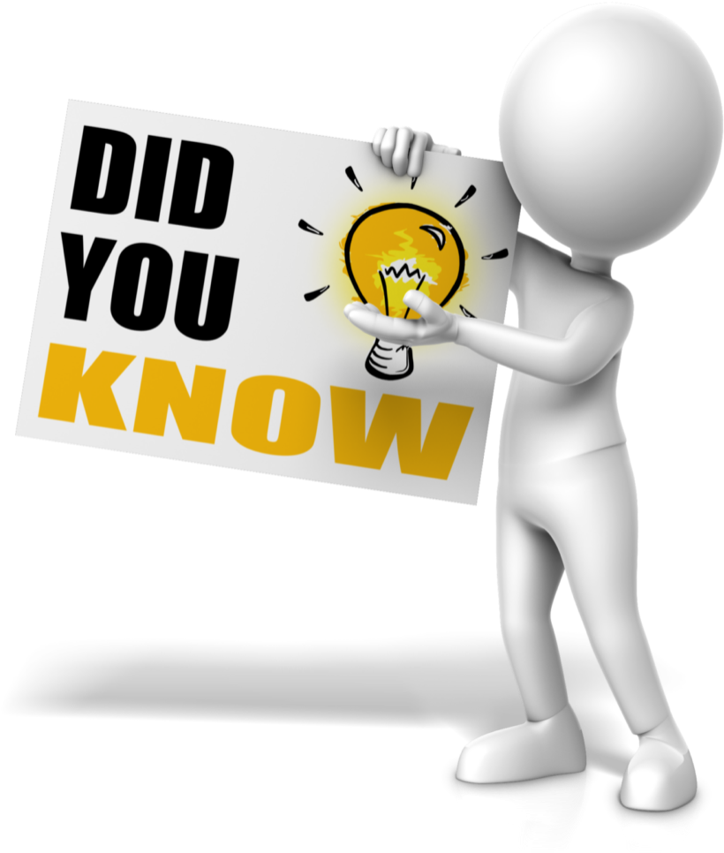
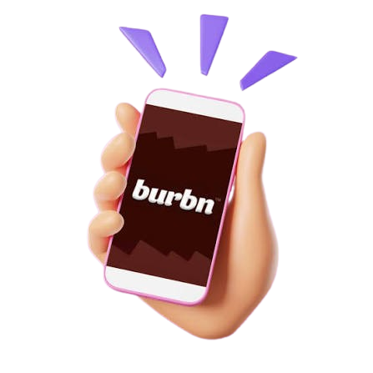
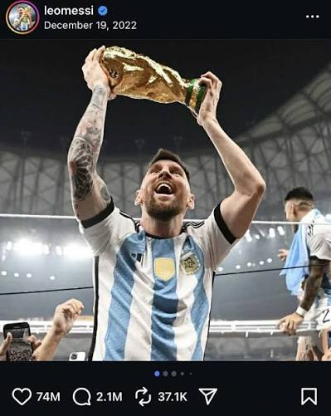
ABOUT INSTAGRAM
Instagram was originally a complex check-in app called Burbn, which included gaming elements and photo sharing, before the founders stripped away every single feature except the photos to launch Instagram.
The most-liked image on the platform is Lionel Messi celebrating his World Cup victory with Argentina. It shattered internet records by amassing over 75 million likes.

Slide 3
PROBLEM STATEMENT
You are hired as a data analyst at Meta and asked to collaborate with Marketing team. Marketing teams wants to leverage Instagram's user data to develop targeted marketing strategies that will increase user engagement, retention, and acquisition.
The objective of this project is to provide insights and recommendation to address the following objectives.

Slide 4

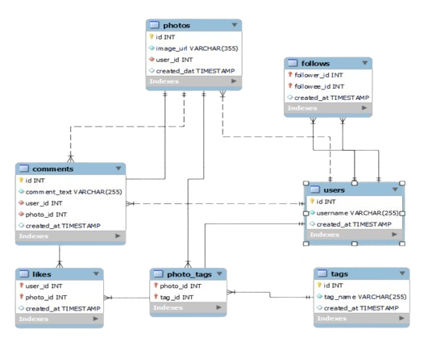
DATA SNAPSHOT
Ig_clone database contains 7 tables which are connected to each other through different relations.
The user’s activity are stored in multiple tables (Posts, Likes, Commenting, Follows).
Its also reflect the user’s behaviour over the platform.
The dataset include the posting data as per the users and all it activity over the platform.
Data Quality
Checked for Missing data (NULL Values) if any present in the dataset.
Analysed and handled if any duplicate is present in the data.
Check the relationship between the tables are valid ones.

Slide 5
ANALYTICAL APPROACH AND TOOLS
Database Exploration: Understood the relational schema and validated relationships across users, posts, likes, comments, follows, and hashtags to ensure accurate analysis.
Advanced SQL Analysis: Applied JOINs, Common Table Expressions (CTEs), Window Functions, Aggregate Functions, Conditional Logic, and Ranking Functions to solve complex business problems and generate analytical insights.
User Behaviour Analysis: Measured user activity, posting frequency, engagement levels, follower networks, inactive users, and overall platform participation.
Content Performance Analysis: Identified top-performing posts, creators, hashtags, and engagement patterns using likes, comments, and interaction metrics.

Slide 6
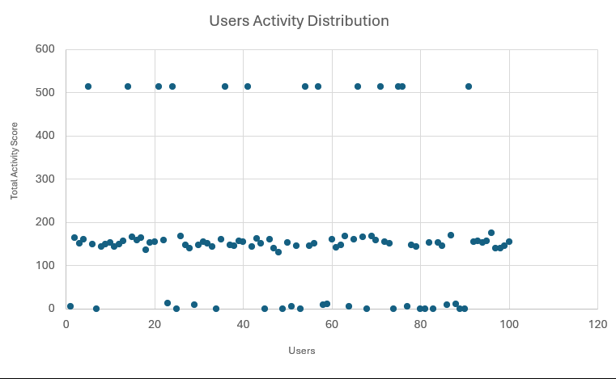
USER DISTRBUTION ACROSS PLATFORM
The chart represents the user distribution based on their activity.
User Activity = Number of likes made by user + Number of Comments made by user + Number of Posts made by user.
Most users fall into the moderately active category, indicating a healthy base of regular platform participants.

Slide 7
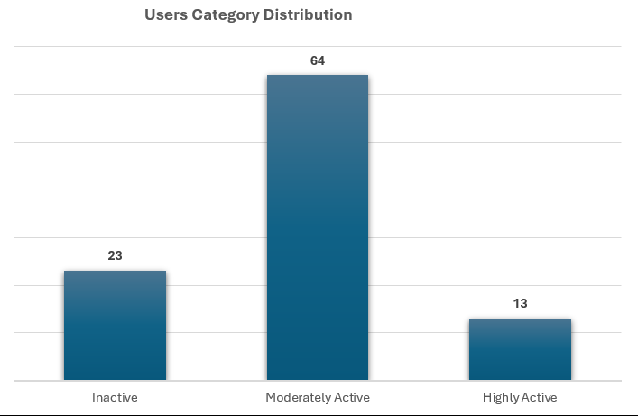
USER CATEGORIZATION
Using the users activity data they are segmented in multiple category.
“Inactive” if score is less than 20
“Moderately Active” if score is between 20-200
“Highly Active” if score is greater than 200.

Slide 8
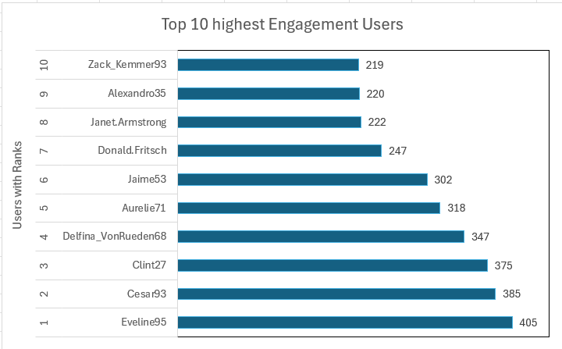
USERS ENGAGEMENT OVER PLATFORM
Analysing Top 10 users based on their engagement.
Engagement is total number of likes and comments received on the users posts.
Helps us determining the users who can be potential influencers or ambassadors.

Slide 9
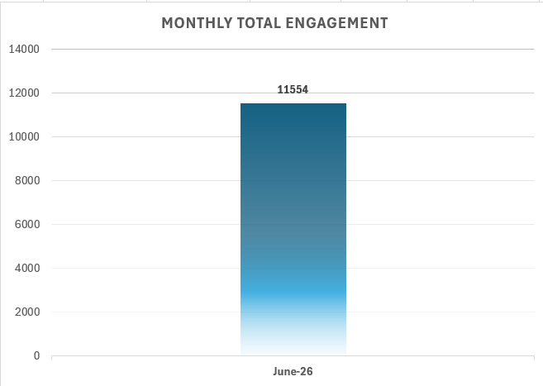
MONTHLY ENGAGEMENT ON PLATFROM
Monthly engagement represents how engaging the platform’s content and user content are monthly.
Essential for analysing the potential month for launching brand campaigns.
Here in JUNE 2026 have total engagement greater than 10,000 which is the highest.

Slide 10
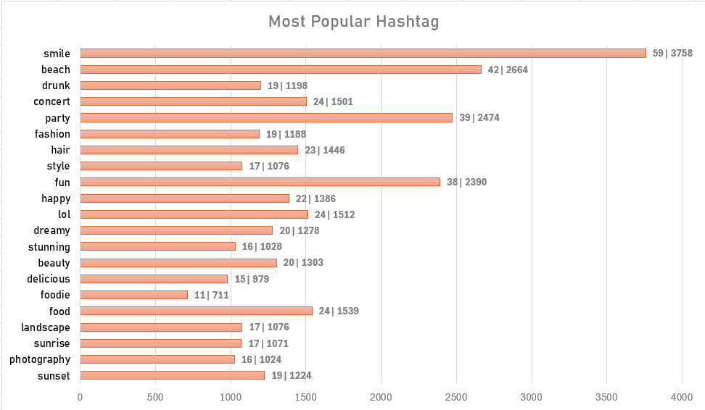
ANALYSING TREND USING HASHTAGS
Trending hashtags indicate the topics and interests that resonate most with users."
This analysis helps us to identify potential trend and which tags are most used and popular among the users.
The first numerical (for e.g. 59) value show how many users have used this tag and second value (for e.g. 3758) shows the popularity.

Slide 11
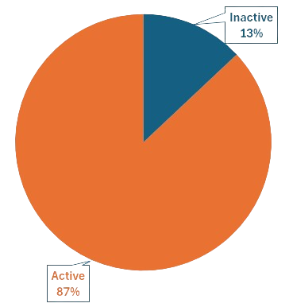
ACTIVE / INACTIVE USERS
Inactive users are those users who have almost zero activity on the platform. i.e. users with 0 likes given, 0 posts made, 0 comments.
Approx 13% of the users are “Inactive”.
Identifying these users help us to understand what measure should be taken for these churned users.

Slide 12
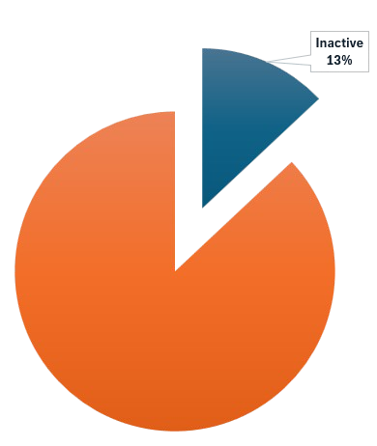
STRATERGIC RECOMMENDATIONS
Inactive 13 %
Re-engage Inactive Users
Launch personalized re-engagement campaigns through email and push notifications.
Recommend accounts and trending content during login to encourage participation.
Offer incentives such as featured content, badges, or challenges for first-time interactions.
Recommend new accounts to follow using mutual connections and shared interests.

Slide 13
Leverage High-Engagement Users
Identify these users as potential creators, influencers, or brand ambassadors.
Promote their content through recommendations and Explore feeds.
Collaborate with them for promotional campaigns and community events.
Promote Trending Hashtags
Feature trending hashtags on the homepage or Explore section.
Recommend relevant hashtags while users create posts.
Create seasonal hashtag campaigns to encourage participation.

Slide 14
Encourage Content Creation
Introduce posting streaks, creator rewards, and gamification.
Provide prompts such as "Share your first post" or "What's happening today?".
Reward consistent posting with profile badges or increased visibility.
Optimize Marketing Campaign Timing
Schedule product launches, advertisements, and promotional campaigns during peak engagement periods.
Publish creator collaborations when users are most active.

Slide 15

CONCLUSION
The analysis revealed key insights into user activity, engagement patterns, inactive users, and trending hashtags across the platform.
These insights enable targeted strategies to improve user engagement, strengthen user retention, and support new user acquisition.
Leveraging high-performing creators, re-engaging inactive users, and promoting trending content can significantly enhance platform growth.

